Slide 1


Cuong, Nguyen Manh
10-Sep-2021

Slide 2

Outline
Executive Summary
Introduction
Methodology
Results
Conclusion
Appendix

Slide 3
Executive Summary
In this capston, I will crawl the data thourgh SpaceX api and webscraping. Using python and Sql to clean data and perform Exploratory Data analysis (EDA) to get the general information about the data. And using mathplotlib, seaborn, and dash_plotly to visualize the data to find out useful information. Lastly, using some of methodology approaches to figure out the best fit model predict landing results such as Logistic Regression, Support Vector Machine, Decision Tree classification, K Nearest Neighbors classification.
After valuation, I find out that Decision Tree classification is the best method for my dataset.

Slide 4
Introduction
Project background and context
The commercial space age is here, companies are making space travel affordable for everyone. Virgin Galactic is providing suborbital spaceflights. Rocket Lab is a small satellite provider. Blue Origin manufactures sub-orbital and orbital reusable rockets. Perhaps the most successful is SpaceX. SpaceX’s accomplishments include: Sending spacecraft to the International Space Station. Starlink, a satellite internet constellation providing satellite Internet access. Sending manned missions to Space. One reason SpaceX can do this is the rocket launches are relatively inexpensive. SpaceX advertises Falcon 9 rocket launches on its website with a cost of 62 million dollars; other providers cost upwards of 165 million dollars each, much of the savings is because SpaceX can reuse the first stage.
The purpose of this project
To predict if the Falcon 9 first stage will land successfully or not by training a machine learning model and use public information. Therefore if we can determine if the first stage will land, we can determine the cost of a launch.

Slide 5


Slide 6
Methodology
Executive Summary
Data collection methodology:
Using requests library to get information about Falcon 9 Rocket from SpaceX API
Using BeautifulSoup to crawl information about Falcon 9 Launces from wikipedia.org
Perform data wrangling
Process the “outcome” to lable the Outcome column
Perform exploratory data analysis (EDA) using visualization and SQL
Perform interactive visual analytics using Folium and Plotly Dash
Perform predictive analysis using classification models
Standardize the data and split to trainset-testset then using GridSearchCV to tunning model

Slide 7
Data Collection
Requests data from SpaceX API
Filter data related to falcon 9 only
Web scraping Falcon 9 and Falcon Heavy Launches Records from Wikipedia
Using BeautifulSoup to get data from Wikipedia
Create user define function to get data from SpaceX API
Preprocessing data from API
Parsing data and convert to DataFrame by using pandas function: json() and json_normalize()
Dealing with missing values
Extract rows and columns
Create DataFrame
Export data to CSV file
Export data to CSV file

Slide 8
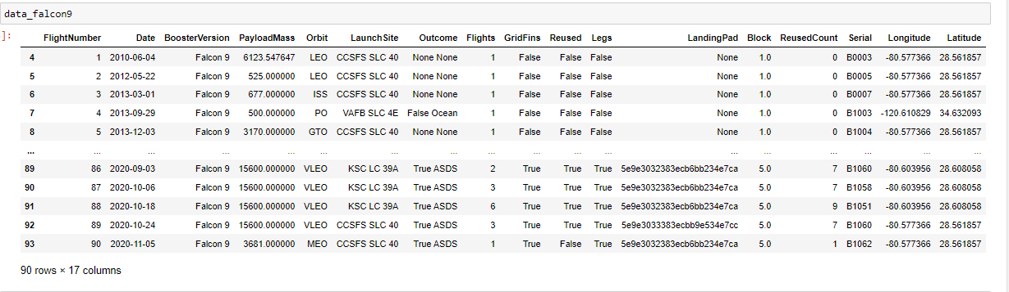
Data Collection – SpaceX API
Requests data from SpaceX API
Filter data related to falcon 9 only
Create user define function to get data from SpaceX API
Preprocessing data from API
Parsing data and convert to DataFrame by using pandas function: json() and json_normalize()
Dealing with missing values
Export data to CSV file
GitHub URL: https://github.com/bnbbdz/Data_sience_ibm_course_capstone/blob/master/02_Notebook/jupyter-labs-spacex-data-collection-api.ipynb

Slide 9
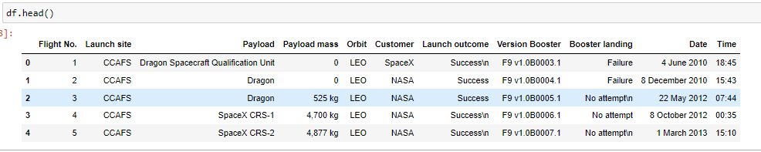
Data Collection - Scraping
Using BeautifulSoup to get data from Wikipedia
Extract rows and columns
Create DataFrame
Export data to CSV file
GitHub URL : https://github.com/bnbbdz/Data_sience_ibm_course_capstone/blob/master/02_Notebook/jupyter-labs-webscraping.ipynb

Slide 10
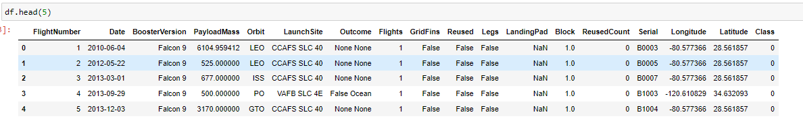
Data Wrangling
Load dataset
Checking missing values and data types
Calculate the number of importance features and outcome
Labeling outcome column
Export data to CSV file
GitHub URL : https://github.com/bnbbdz/Data_sience_ibm_course_capstone/blob/master/02_Notebook/labs-jupyter-spacex-Data%20wrangling.ipynb
10

Slide 11
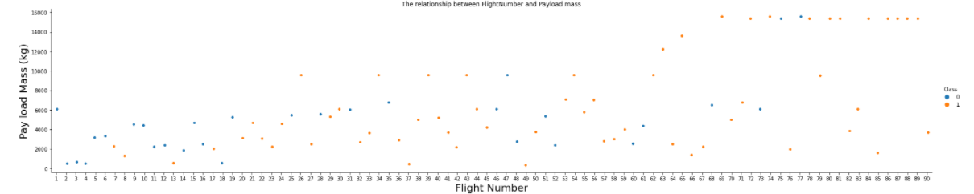
EDA with Data Visualization
I used some kind of charts like scatter point chart, line chart, bar chart.
Through catter point chart I can see the relationship between features such as The relationship between FlightNumber and Payload mass , The relationship between Flight Number and Launch Site, The relationship between Payload mass and Launch Site , etc
Based on bar chart I can see the success rate in different Orbit type,
And finally I used line chart to see the success trend line during the period 2010 to 2020.
GitHub URL : https://github.com/bnbbdz/Data_sience_ibm_course_capstone/blob/master/02_Notebook/jupyter-labs-eda-dataviz.ipynb
For example you can see on the chart “The relationship between FlightNumber and Payload mass” that as the flight number increases, the first stage is more likely to land successfully. The payload mass is also important; it seems the more massive the payload, the less likely the first stage will return

Slide 12
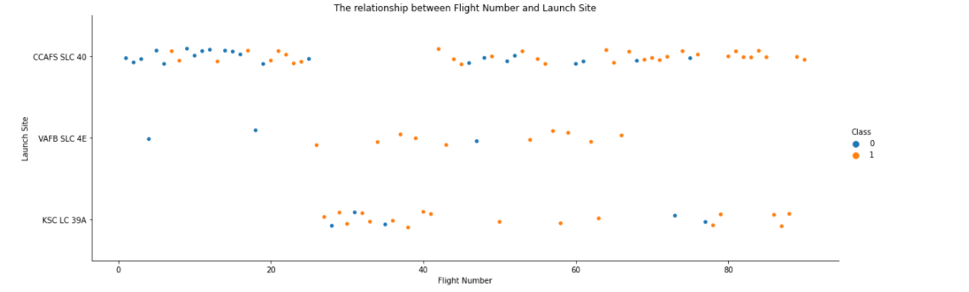
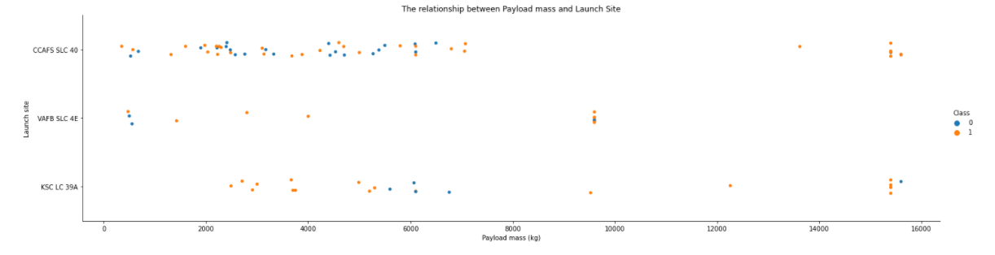
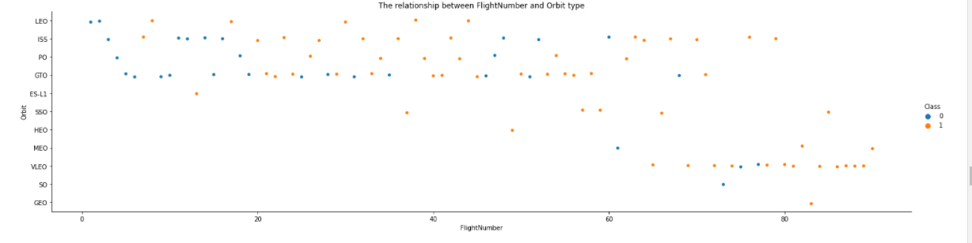
EDA with Data Visualization

Slide 13
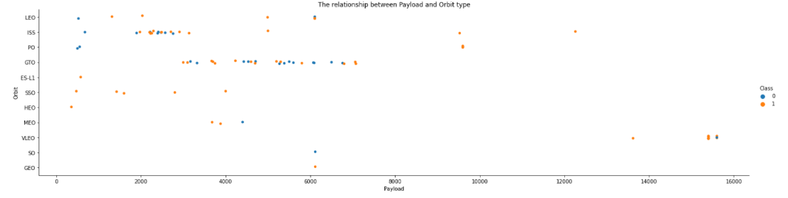
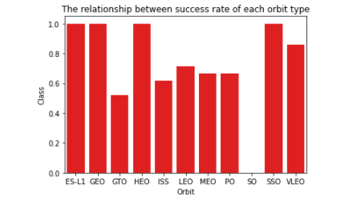
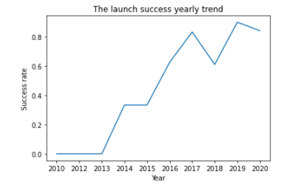
EDA with Data Visualization

Slide 14
EDA with SQL
Connect to the database using SQL magic commands
Using distinct to Display the names of the unique launch sites in the space mission
Using Like and limit to Display 5 records where launch sites begin with the string 'CCA‘
Using aggregate function sum() to calculate the total payload mass carried by boosters launched by NASA (CRS)
Using aggregate function avg () and like to calculate average payload mass carried by booster version F9 v1.1
Using aggregate function min () and like to get the first successful landing outcome in ground pad was achieved
Using between to filter the names of the boosters which have success in drone ship and have payload mass greater than 4000 but less than 6000
Using group by to List the total number of successful and failure mission outcomes
Using subquery to the names of the booster_versions which have carried the maximum payload mass
Using group by and order by to Rank the count of landing outcomes (such as Failure (drone ship) or Success (ground pad)) between the date 2010-06-04 and 2017-03-20, in descending order
GitHub URL : https://github.com/bnbbdz/Data_sience_ibm_course_capstone/blob/master/02_Notebook/jupyter-labs-eda-sql-coursera.ipynb

Slide 15
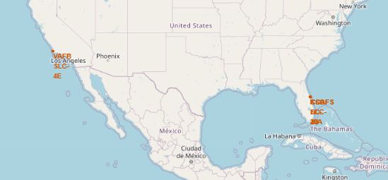
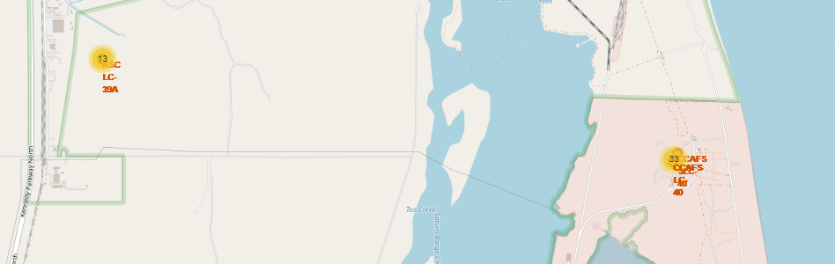
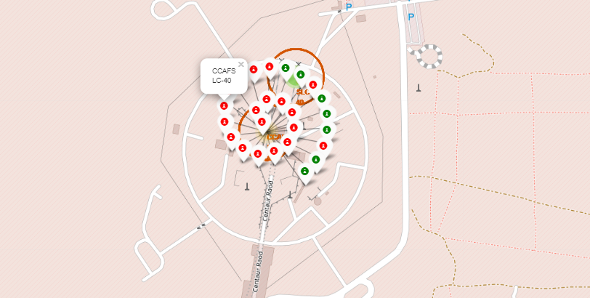
Build an Interactive Map with Folium
The launch success rate may depend on many factors such as payload mass, orbit type, and so on. It may also depend on the location and proximities of a launch site, i.e., the initial position of rocket trajectories. Finding an optimal location for building a launch site certainly involves many factors and hopefully it could discover some of the factors by analyzing the existing launch site locations.
I used Map with Folium to visualize and mark all the launch sites on the map, then I marked the success/failed launches for each site on the map.
GitHub URL : https://github.com/bnbbdz/Data_sience_ibm_course_capstone/blob/master/02_Notebook/lab_jupyter_launch_site_location.ipynb

Slide 16
Build a Dashboard with Plotly Dash
I created plots and interactions to have more understanding about the dataset through answering some questions
Which site has the largest successful launches?
Which site has the highest launch success rate?
Which payload range(s) has the highest launch success rate?
Which payload range(s) has the lowest launch success rate?
Which F9 Booster version (v1.0, v1.1, FT, B4, B5, etc.) has the highest
I used a pie chart to check the proportion of each site in the total success launches for all sites and the proportion of success or failed launches in each site. And using the scatter plot to examine the changes in the correlation between Payload and Success in each site when I change the Payload
GitHub URL : https://github.com/bnbbdz/Data_sience_ibm_course_capstone/blob/master/03_Py_file/spacex_dash_app.py

Slide 17
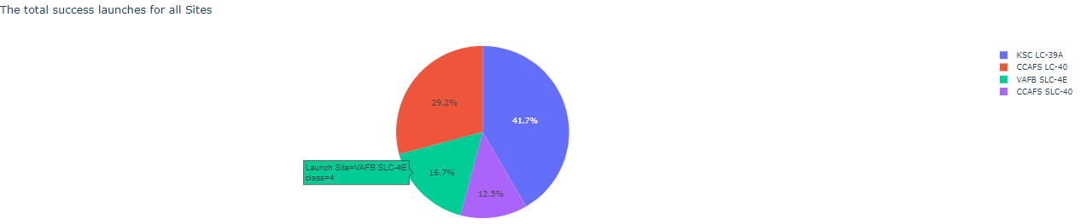
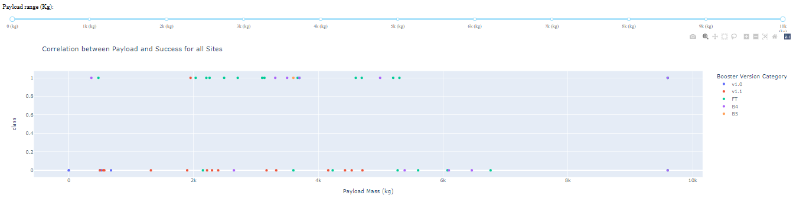
Build a Dashboard with Plotly Dash

Slide 18
Predictive Analysis (Classification)
I used the sklearn library to do some of methodology approaches to figure out the best fit model predict landing results such as Logistic Regression, Support Vector Machine, Decision Tree classification, K Nearest Neighbors classification. Standardize the data and split to trainset-testset then using GridSearchCV to tunning model. As the result, the Decision Tree classification give the best performance in these models with my data set
Standardize dataset
Create Machine learning models
Evaluate models
Split data into trainset and testset
Train models
Using the GridSearchCV to find the best parameter for models
GitHub URL : https://github.com/bnbbdz/Data_sience_ibm_course_capstone/blob/master/02_Notebook/SpaceX_Machine%20Learning%20Prediction_Part_5.ipynb

Slide 19
Results
Exploratory data analysis results

Slide 20
Results
Interactive analytics demo in screenshots

Slide 21
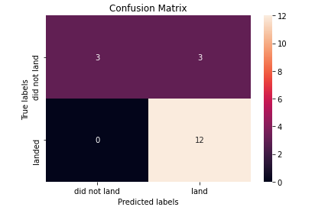
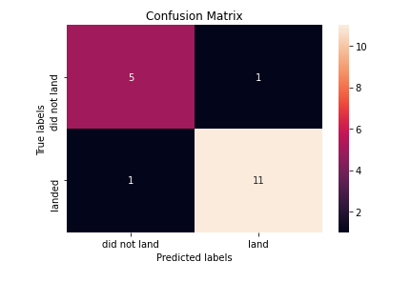
Results
Predictive analysis results

Slide 22


Slide 23
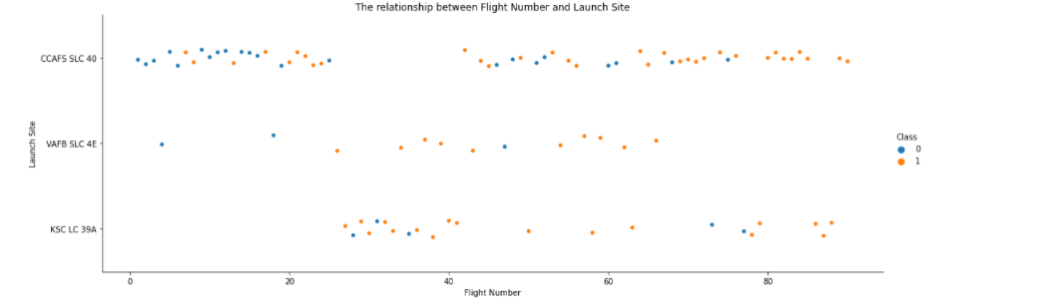
Flight Number vs. Launch Site
Scatter plot of Flight Number vs. Launch Site
We see that as the flight number increases, the first stage is more likely to land successfully for all sites. The Launch site is also important; KSC LC-39A and VAFB SLC 4E have higher success rates than CCAFS LC-40.

Slide 24
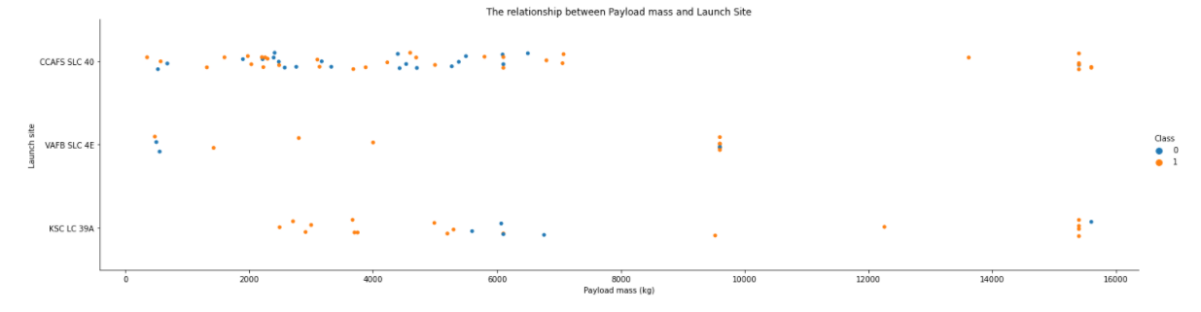
Payload vs. Launch Site
Scatter plot of Payload vs. Launch Site
We see that as the Payload increases, the first stage is more likely to land successfully for all sites. But when we see the Payload mass between 0 and 8000 (kg), there is a different trend between the launch sites:
CCAFS SLC 40: there is no difference in the Payload mass
VAFB SLC 4E: The Payload mass increases, the success rate increases respectively
KSC LC 39A: The Payload mass increases, the success rate decreases respectively

Slide 25
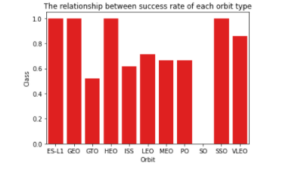
Success Rate vs. Orbit Type
Bar chart for the success rate of each orbit type
We see that ES-L1, GEO, HEO, SSO orbit types have the highest success rate achieve nearly 100%, while SO orbit type has the lowest success rate, and other orbit types have the success rate between 50% and 80%.

Slide 26
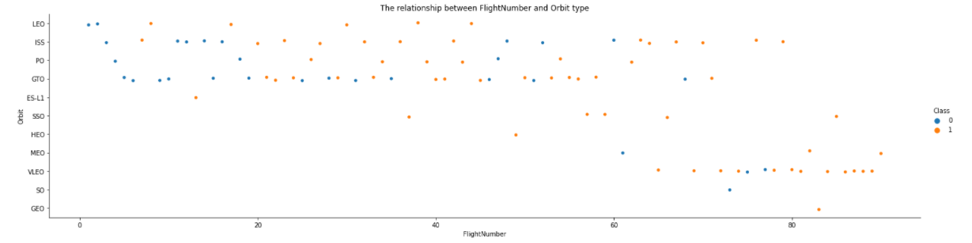
Flight Number vs. Orbit Type
Scatter plot of Flight number vs. Orbit type
We see that as the Flight number increases, the first stage is more likely to land successfully for all Orbit types. But the SO orbit type and GTO have the lowest success rate, however GTO success rate is gradually improved

Slide 27
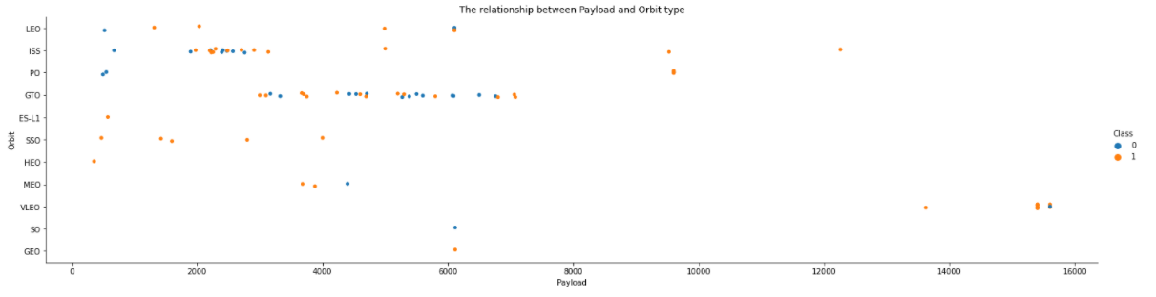
Payload vs. Orbit Type
Scatter plot of Payload vs. Orbit type
We see that as the Payload increases, the first stage is more likely to land successfully for almost Orbit types. But there is a different trend between Orbit types:
GTO: there is no difference in the Payload mass
MEO, LEO and VLEO: The Payload mass increases, the success rate decreases respectively

Slide 28
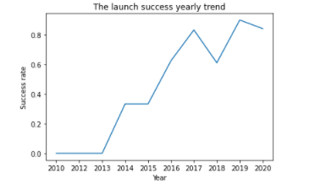
Launch Success Yearly Trend
Line chart of yearly average success rate
We see that as the success rate increase over the year. but 2018 and 2020 have a slight decrease in the success rate

Slide 29
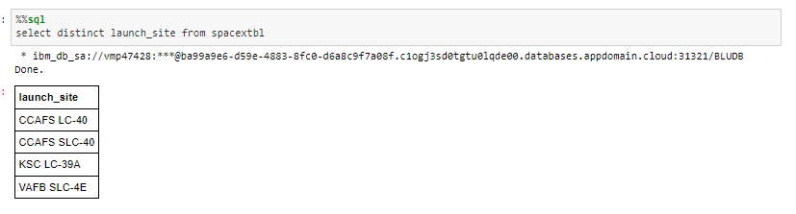
All Launch Site Names
Using distinct to display the names of the unique launch sites. There is 4 launch sites in the data set

Slide 30
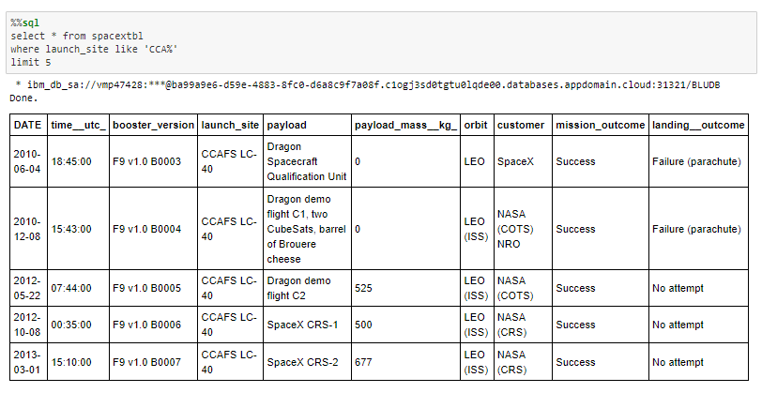
Launch Site Names Begin with 'CCA'
Using limit 5 to display 5 records where launch sites begin with `CCA`

Slide 31
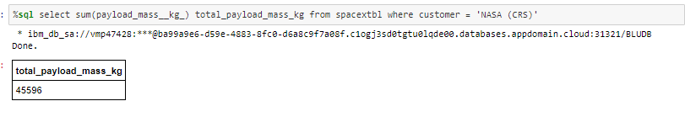
Total Payload Mass
Using sum() function and where clause to calculate the total payload carried by boosters from NASA. The total Payload from NASA is 45596 kg

Slide 32
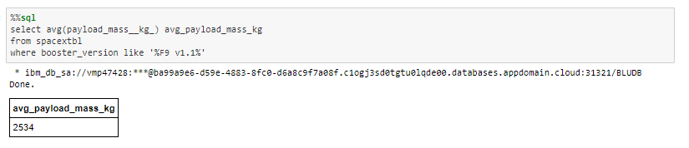
Average Payload Mass by F9 v1.1
Using avg() function alculate the average payload mass carried by booster version F9 v1.1. The result is 2534 kg

Slide 33
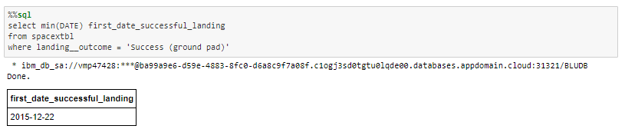
First Successful Ground Landing Date
Using min() function to find the dates of the first successful landing outcome on ground pad. The first date is 22/12/2015

Slide 34
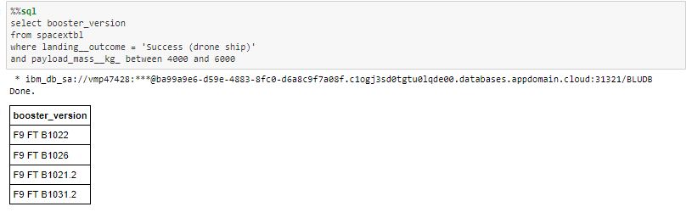
Successful Drone Ship Landing with Payload between 4000 and 6000
Using between in where clause to list the names of boosters which have successfully landed on drone ship and had payload mass greater than 4000 but less than 6000

Slide 35
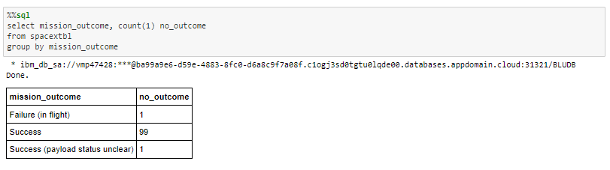
Total Number of Successful and Failure Mission Outcomes
Using group by and count to calculate the total number of successful and failure mission outcomes

Slide 36
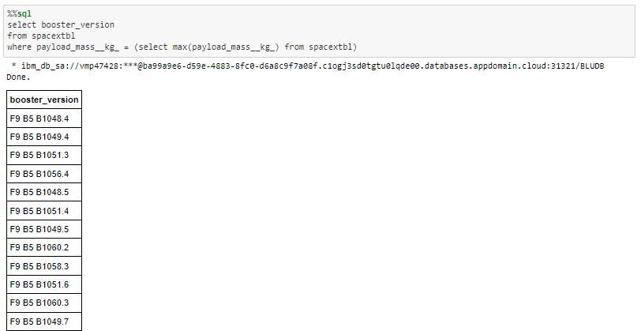
Boosters Carried Maximum Payload
Using max() function and subquery to list the names of the booster which have carried the maximum payload mass

Slide 37
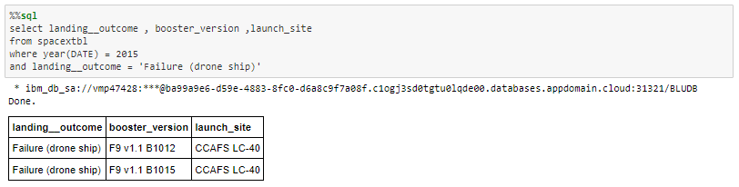
2015 Launch Records
Using year() function to extract year to list the failed landing_outcomes in drone ship, their booster versions, and launch site names for in year 2015

Slide 38
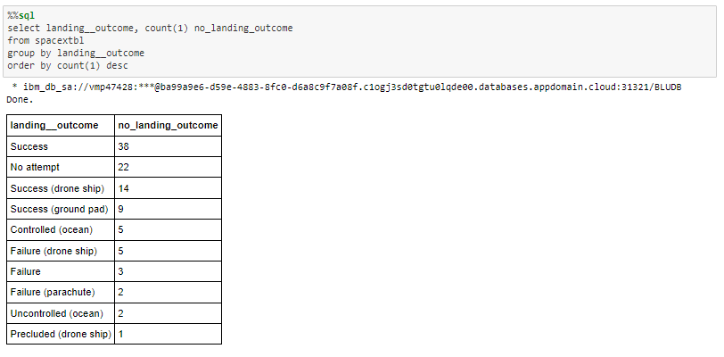
Rank Landing Outcomes Between 2010-06-04 and 2017-03-20
Using group by, count() function and order by to rank the count of landing outcomes (such as Failure (drone ship) or Success (ground pad)) between the date 2010-06-04 and 2017-03-20, in descending order

Slide 39


Slide 40
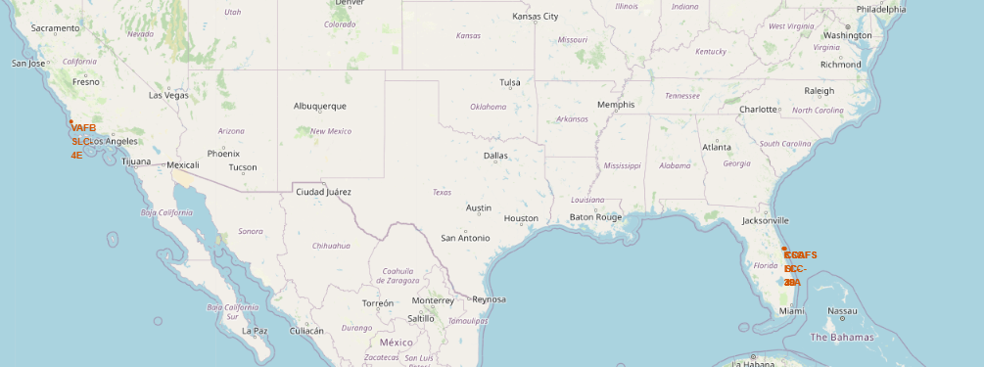
Launch sites location

Slide 41
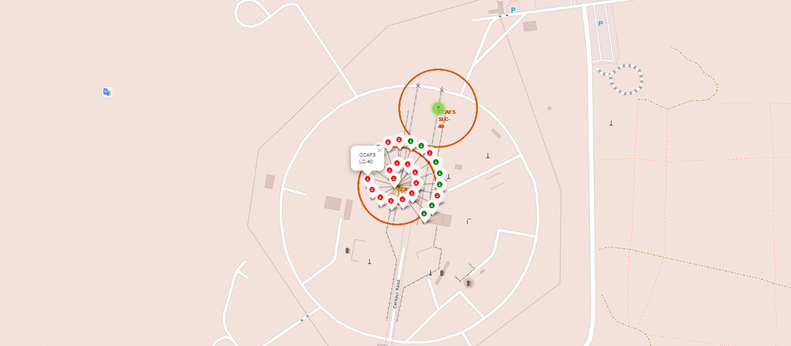
Outcomes in each Launch sites location

Slide 42
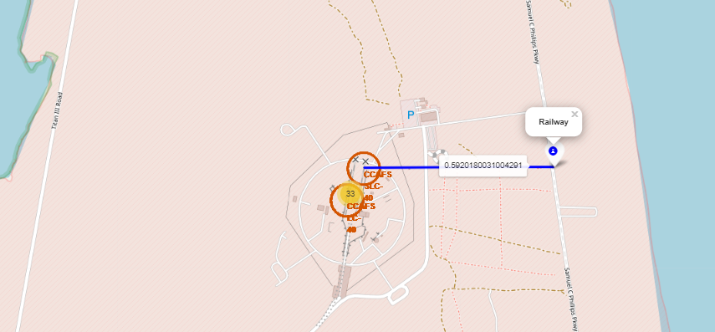
Distance between launch site to its proximities railway

Slide 43


Slide 44
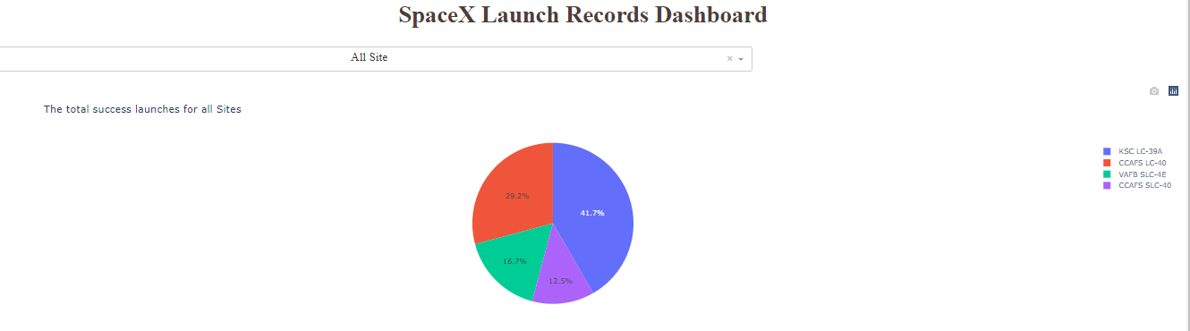
Success rate for all sites
This pie chart to check the proportion of each site in the total success launches for all sites. As we can see, KSC LC-39A has the highest proportion in the total of success launches.

Slide 45
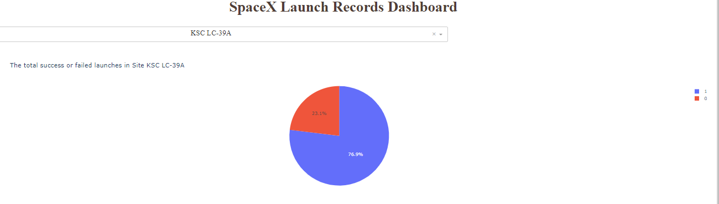
The ratio of success/failed in the site KSC LC-39A
KSC LC-39A has the highest proportion in the total of success launches. Also it has the highest success rate is 76.9%

Slide 46
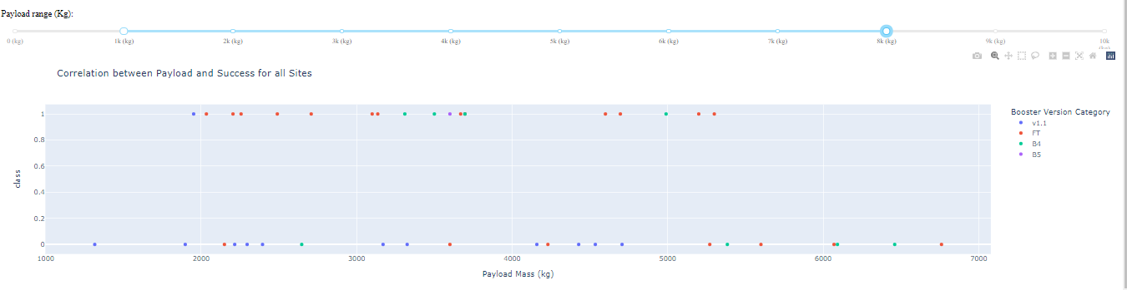
Correlation between Payload and Success for all sites
As we can see on the Payload range between 1000 kg and 8000 kg, Booster version B5 has the highest success rate, after that is FT and B4 version. And v1.1 version has lowest success rate. And as the Payload increase, the percentage of a success rate decrease

Slide 47


Slide 48
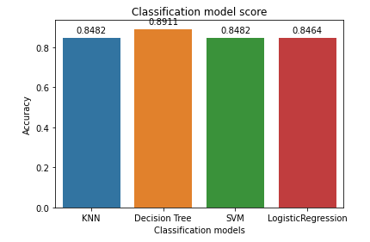
Classification Accuracy
As we can see on the bar chart above, The Decision tree model has the highest accuracy with a score is 0.8911. Therefore, the Decision tree model is the best performing model in 4 models that were trained.

Slide 49
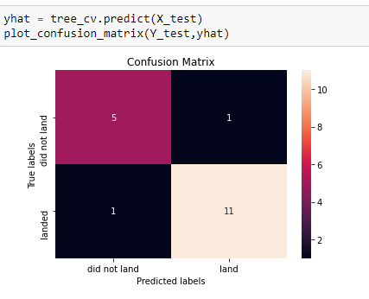
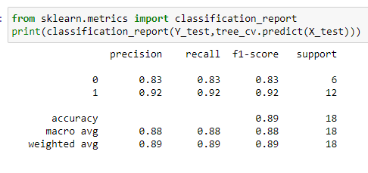
Confusion Matrix
As we can see on the onfusion matrix of the Decision tree model above, there is 16 cases were predicted correctly and 2 cases were given wrong (1 case Type 1 error and 1 case Type 2 error).
In first row, the actual “did not land” is 6 cases, in test set predict “did not land” is 5 cases, predict “land” is 1 case, this mean the classifier predict correctly 5/6 cases
In second row, the actual “land” is 12 cases, in test set predict “did not land” is 1 cases, predict “land” is 11 case, this mean the classifier predict correctly 11/12 cases

Slide 50
Conclusions
SpaceX advertises Falcon 9 rocket launches on its website with a cost of 62 million dollars; other providers cost upwards of 165 million dollars each, much of the savings is because SpaceX can reuse the first stage. Through the processing such as Data collection, data wrangling, exploratory data analysis (EDA) using visualization and SQL, interactive visual analytics, and predict if the Falcon 9 first stage will land successfully or not using classification models like KNN, Decision tree, SVM, Logistic regression,...
Throughout the EDA process, I found out that there are various features that are correlated with the Landing successfully such as : the Orbit type, the Payload mass, The flight number, Launch site, etc.
And I do a lot of ML models and evaluated these models to find the best-performing model. As the result, I discovered that the Decision tree model fit with the dataset I was collected and give 89,11% accuracy.

Slide 51
Appendix
Capstone github repository: https://github.com/bnbbdz/Data_sience_ibm_course_capstone.git

Slide 52


